Slide 1
Lecture 14 Unlicensed LPWANs
CS397/497 – Wireless Protocols for IoT
Branden Ghena – Spring 2022
Materials in collaboration with Pat Pannuto (UCSD)

Slide 2
Today’s Goals
Overview of unlicensed-band LPWAN approaches
LoRaWAN
Sigfox
802.11ah
TV Whitespaces
Deep-dive into challenges LPWANs face

Slide 3
Resources
LoRaWAN
LoRaWAN Specification version 1.1
LoRaWAN Regional Parameters version 1.0.2
Sigfox
Sigfox Technical Overview
IETF Descriptions
https://www.ietf.org/proceedings/97/slides/slides-97-lpwan-25-sigfox-system-description-00.pdf
https://tools.ietf.org/html/draft-zuniga-lpwan-sigfox-system-description-04

Slide 4
Outline
Wide-Area Network Background
Unlicensed LPWANs
LoRaWAN
Sigfox
802.11ah
TV Whitespaces
LPWAN Challenges

Slide 5
Wide area networks
Communication at the region/city scale rather than the building/residence scale
Throughout cities
Agricultural deployments
Industrial facilities
City-scale sensing is one very popular domain
What might we want to sense throughout a city?

Slide 6
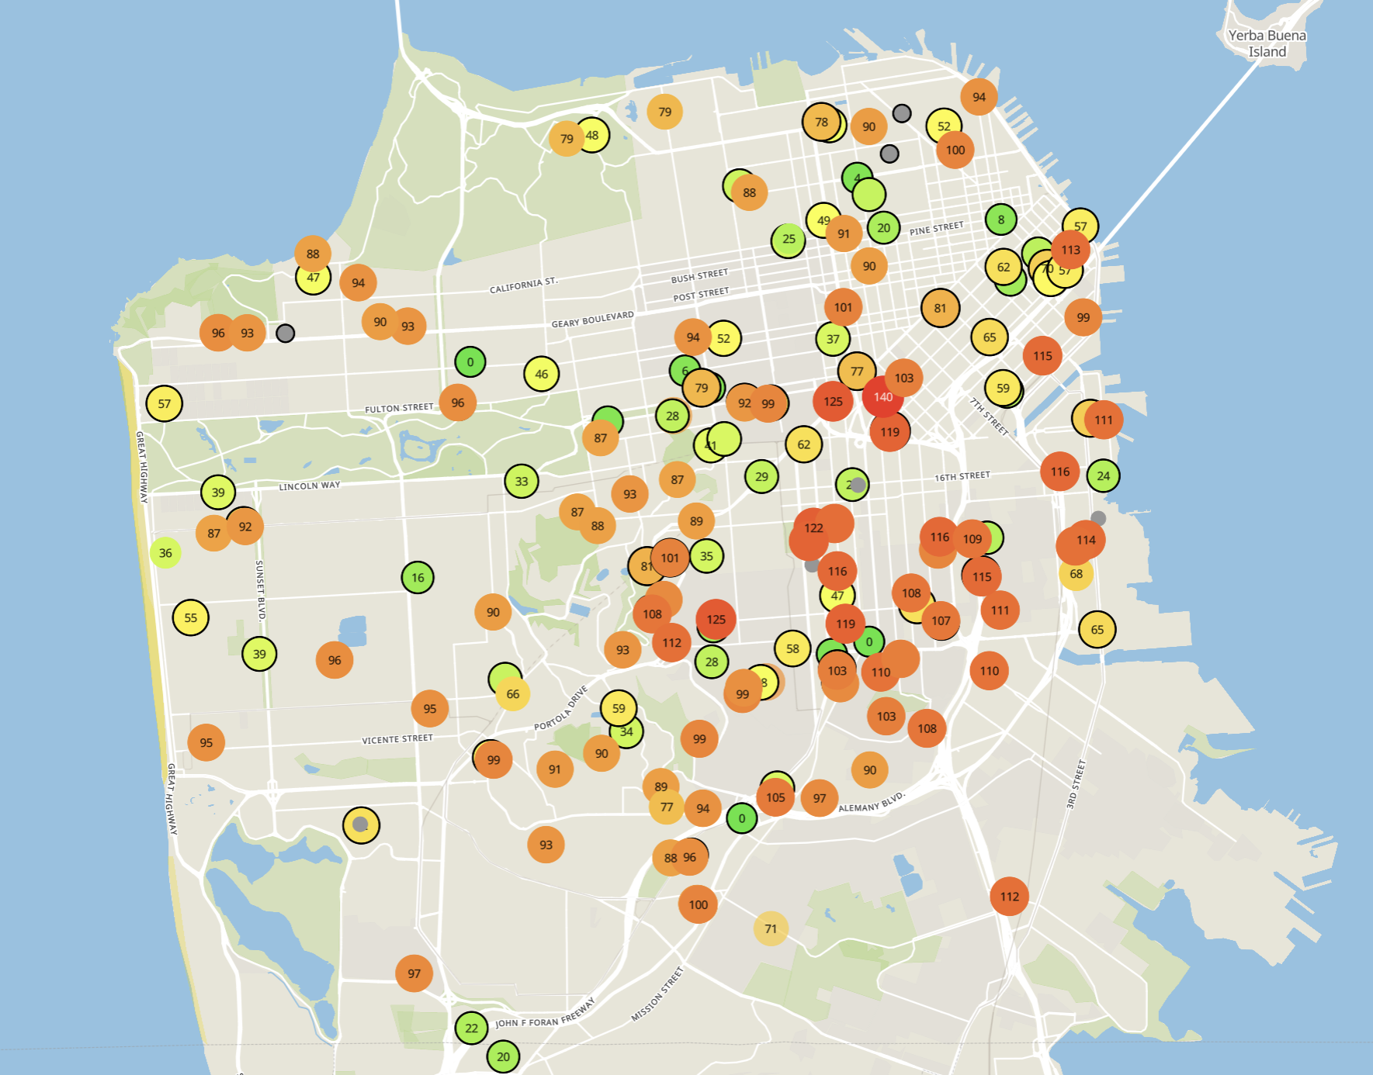
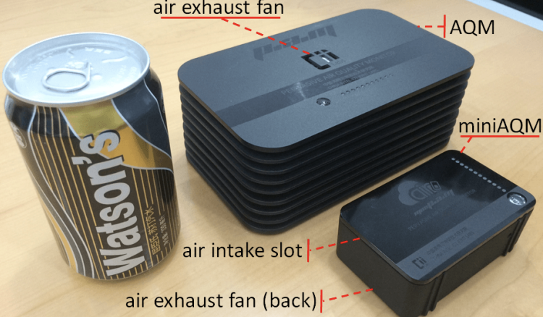
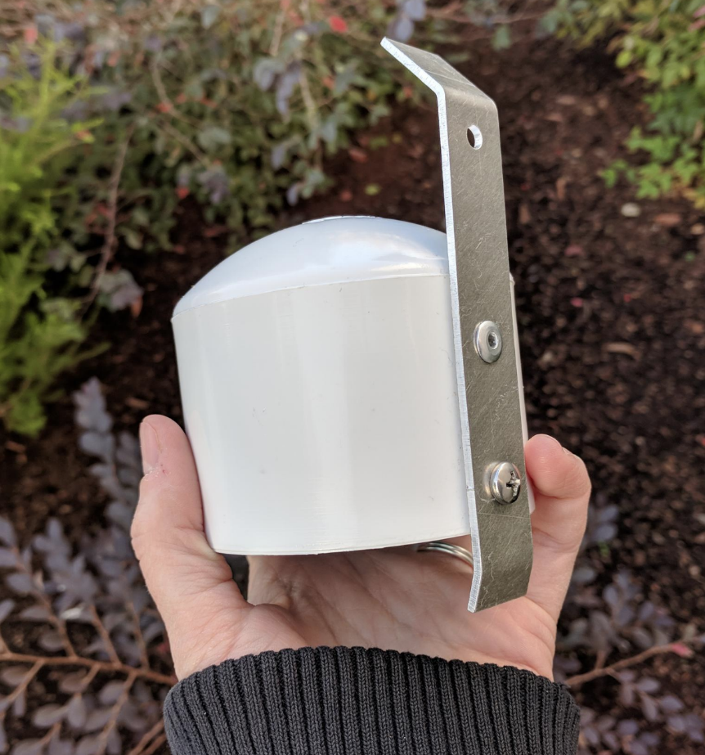
Example application: air quality monitoring
[1]
[2]
[2]
[1] Cheng et al. AirCloud: a cloud-based air-quality monitoring system for everyone. 2014. [2] Purple Air. 2019.

Slide 7
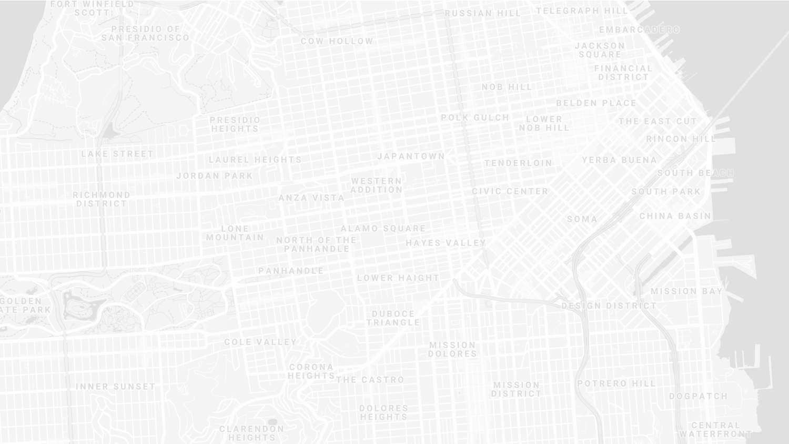
How do we collect data from a sensor?
Manually collect measurements
Too much work
Connect it to WiFi (or Ethernet)
Too many separate networks
Pay for cellular access
Too expensive for many devices

Slide 8
How do we collect data from MANY sensors?
Manually collect measurements
Too much work
Connect it to WiFi (or Ethernet)
Too many separate networks
Pay for cellular access
Too expensive for many devices

Slide 9
We need another network option
Requirements:
Wide area of coverage
Deploy fewer gateways
Low power
So we can deploy on batteries
Doesn’t need high throughput
Sensor data is relatively small

Slide 10
Long-range, low-data needs haven’t historically been met
WiFi
Data
Throughput
Range

Slide 11
Long-range, low-data needs haven’t historically been met
WiFi
Data
Throughput
Bluetooth
BLE
Zigbee
Range

Slide 12
Long-range, low-data needs haven’t historically been met
WiFi
Higher Power & Higher Cost
Data
Throughput
Bluetooth
BLE
Zigbee
Lower Power & Lower Cost
Range

Slide 13
Long-range, low-data needs haven’t historically been met
WiFi
4G
Higher Power & Higher Cost
3G
3G
Data
Throughput
2G
Bluetooth
2G
BLE
Zigbee
Lower Power & Lower Cost
Range

Slide 14
Long-range, low-data needs haven’t historically been met
WiFi
4G
Higher Power & Higher Cost
3G
Data
Throughput
Bluetooth
2G
Low-Power Wide-Area Networks
BLE
Zigbee
Lower Power & Lower Cost
Range

Slide 15
LPWANs overview (common qualities)
Unlicensed 915 MHz band (902-928 MHz)
Higher power transmissions: ~20 dBm (100 mW)
Low data rate 100 kbps or less
Range on the order of multiple kilometers
Simple Aloha access control

Slide 16
Outline
Wide-Area Network Background
Unlicensed LPWANs
LoRaWAN
Sigfox
802.11ah
TV Whitespaces
LPWAN Challenges

Slide 17
LoRaWAN
Open communication standard built with proprietary LoRa PHY
Low rate (1-20 kbps) and long range (~5 km)
Shorter range than Sigfox but much higher bit rate
Most popular LPWAN protocol
Target of academic research
Industry involvement in hardware and deployments

Slide 18
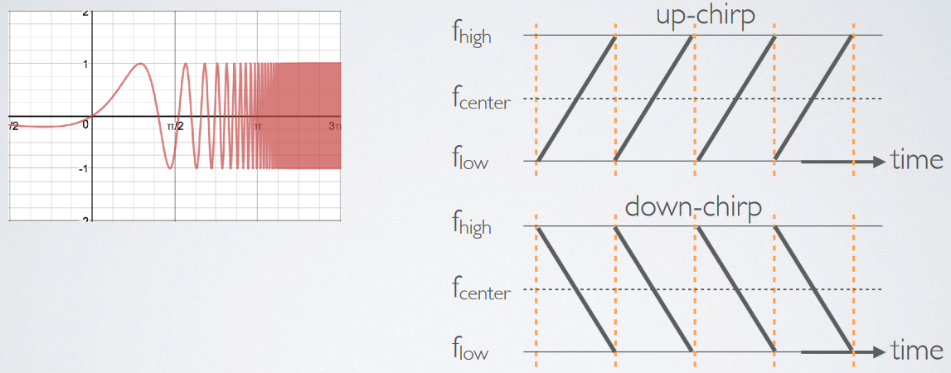
LoRa PHY uses a different modulation
Chirp Spread Spectrum (CSS)
Modulation technique where frequency is varied linearly from lowest to highest within a channel

Slide 19
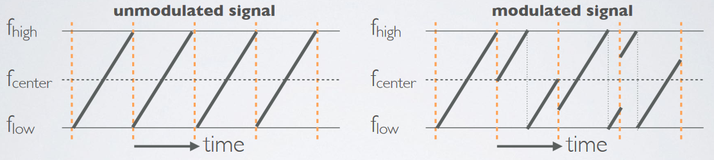
Chirp Spread Spectrum
Data is modulated in the starting and ending points of chirp
Frequency increases linearly, modulo bounds of the channel

Slide 20
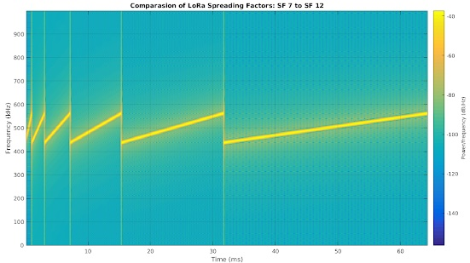
CSS has a Spreading Factor which determines bit rate
Spreading Factor is essentially the rate-of-change of frequency
Slope of the line
Lower values of spreading factor (steeper slope) are faster data rate
Important: different spreading factors are (mostly) orthogonal!
Two can overlap in time, space, and channel without a collision

Slide 21
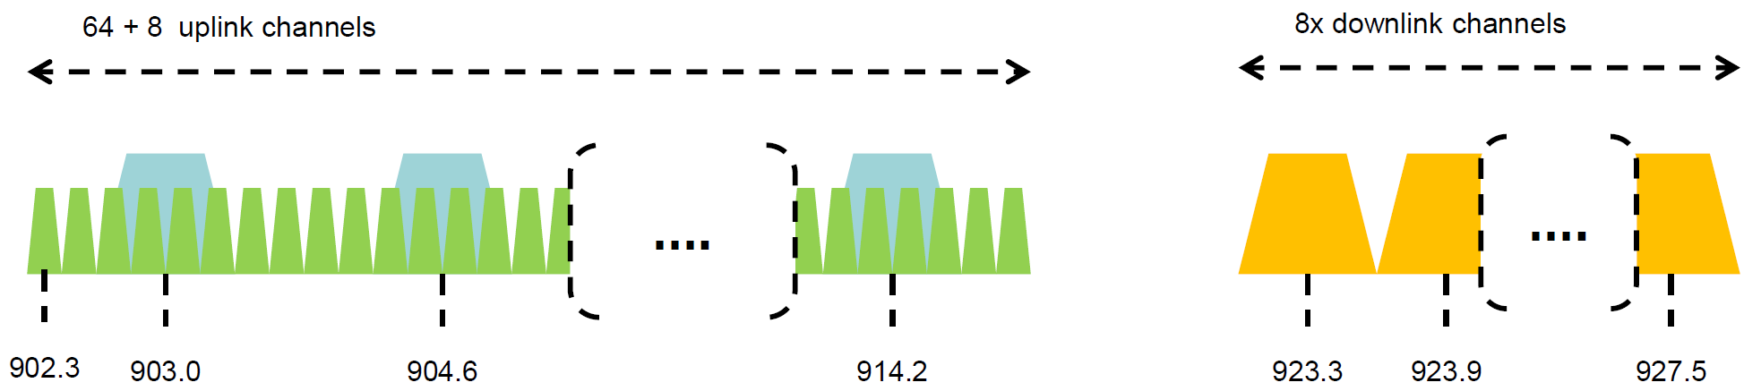
LoRaWAN channels (in the US)
Sixty-four, 125 kHz uplink channels
Frequency Hopping over the 64 uplink channels
Plus eight, 500 kHz overlapping uplink channels (not very used in practice)
Eight, 500 kHz downlink channels

Slide 22
LoRaWAN gateways
No synchronization with end devices
Instead listen to entire bandwidth simultaneously
Only 12 MHz total
Recognize preambles and allocate hardware to decode packet
Cheap gateways: 8 decoders
Good gateways: 64 decoders

Slide 23
LoRaWAN data rates
Data Rate Index | Spreading Factor | Bit Rate
125 kHz Uplink Rates
0 | SF10, 125 kHz | 980 bps
1 | SF9, 125 kHz | 1760 bps
2 | SF8, 125 kHz | 3125 bps
3 | SF7, 125 kHz | 5470 bps
500 kHz Uplink Rates
4 | SF8, 500 kHz | 12500 bps
500 kHz Downlink Rates
8 | SF12, 500 kHz | 980 bps
9 | SF11, 500 kHz | 1760 bps
10 | SF10, 500 kHz | 3900 bps
11 | SF9, 500 kHz | 7000 bps
12 | SF8, 500 kHz | 12500 bps
13 | SF7, 500 kHz | 21900 bps
Data rate options depend on channel in use
Unbalanced uplink and downlink
64-channel uplink
1-5 kbps data rate
Allowable rates based on US dwell time restriction (400 ms)
Different in different regions

Slide 24
LoRaWAN link budget
Typical TX power 20 dBm
Up to 30 dBm for 64-channel hopping
Up to 26 dBm for 8-channel hopping
Receive sensitivity -119 dBm
Compare to -100 dBm for 802.15.4 and -95 dBm for BLE
Resulting range is about a kilometer in urban environments

Slide 25
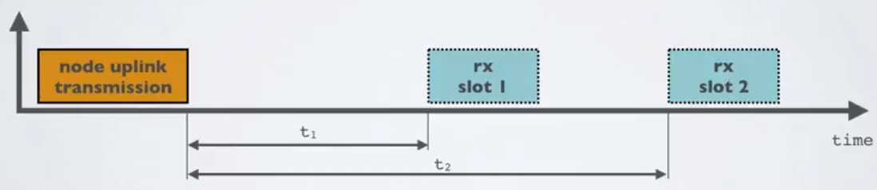
LoRaWAN MAC
Uplink: Aloha - transmit whenever
Randomly split across 64 uplink channels (reduced odds of collision)
Devices a different spreading factors also do not collide
Packets are very long though: up to 400 ms in duration
Downlink: listen-after-send (class A device)
Two windows for RX on different channels

Slide 26
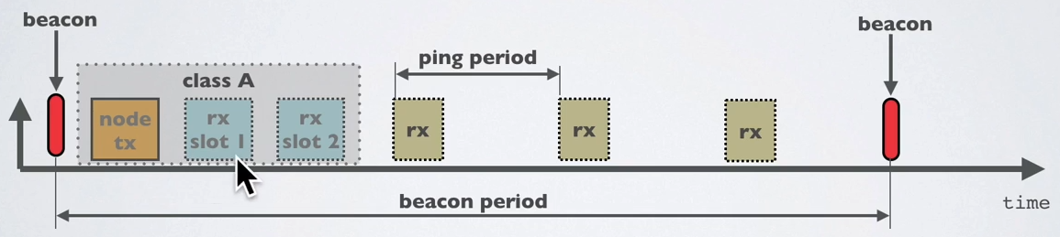
Optional downlink mechanisms
Periodic listening (class B device)
Synchronized with periodic beacons
TX still unsynchronized Aloha
Mostly unused
Continuous listening (class C device)
Always-on receivers

Slide 27
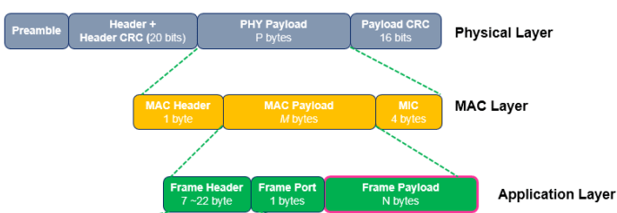
LoRaWAN packet format
Frame header includes device address
MAC Payload maximum size depends on data rate
Again based on dwell time in the US
Data Rate Index | MAC Payload Size
0 | 19 bytes
1 | 61 bytes
2 | 133 bytes
3 | 250 bytes
4 | 250 bytes

Slide 28
LoRaWAN network details

Slide 29
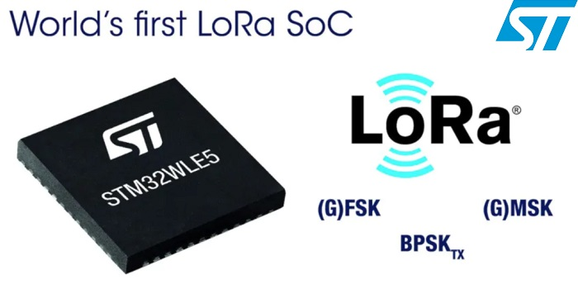
LoRaWAN hardware
Numerous hardware modules and development kits
Almost all use Semtech radio chips (Semtech owns LoRa PHY)
Recent addition: STM32WLE5 LoRa SoC
Cortex-M4 + LoRa radio (analogous to nRF52840)

Slide 30
LoRaWAN network providers
You can always manage your own network
Buy a gateway and run whatever backend software you want
Somewhat-managed network providers
The Things Network (predominantly in Europe)
But available in the US too!
Helium
Anyone can buy and install their own gateway, which serves everyone
Microtransactions to pay for communication

Slide 31
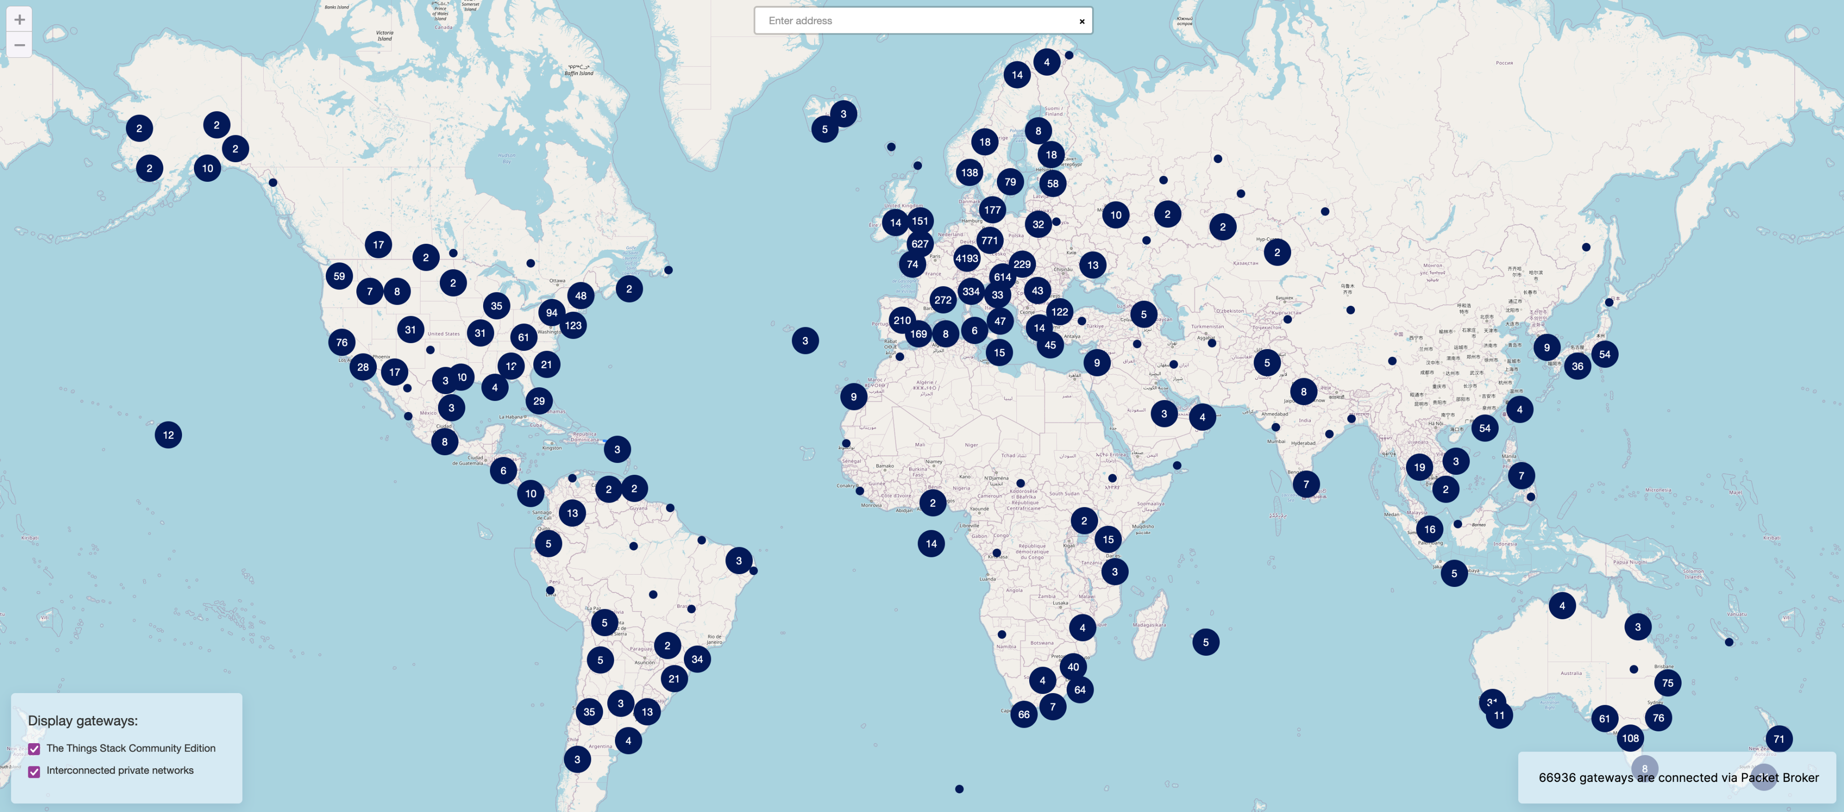
TTN Scale [Jan 2022]

Slide 32
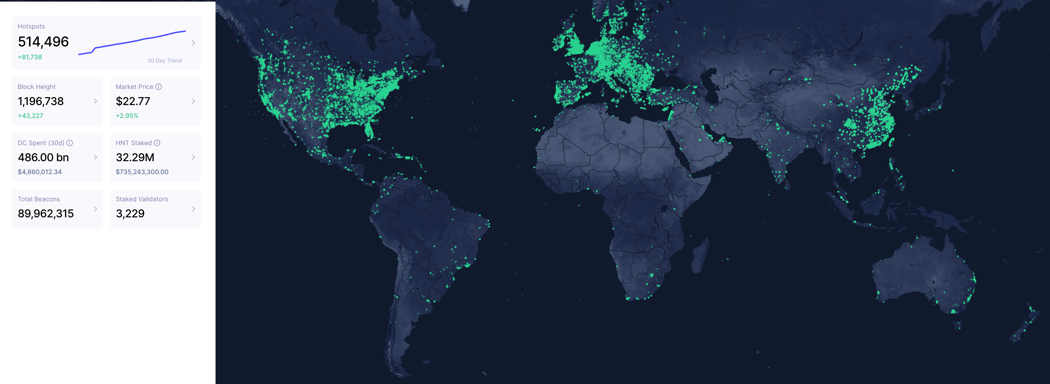
Helium Scale [Jan 2022]
May 2022: 800,000 hotspots, with +80K in last 30 days

Slide 33
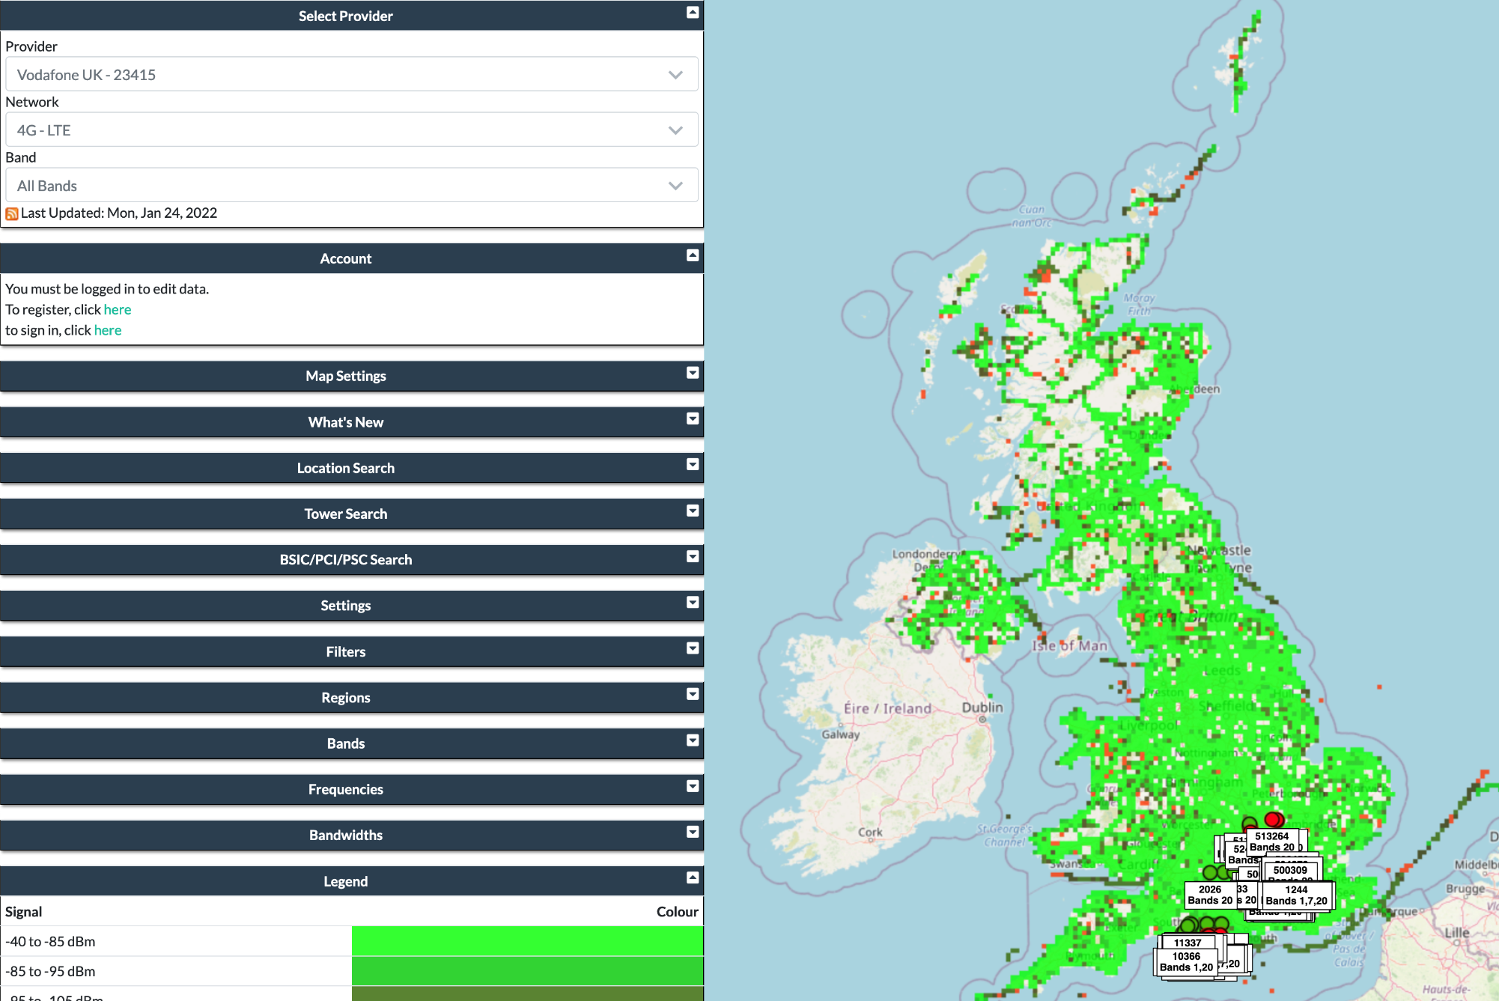
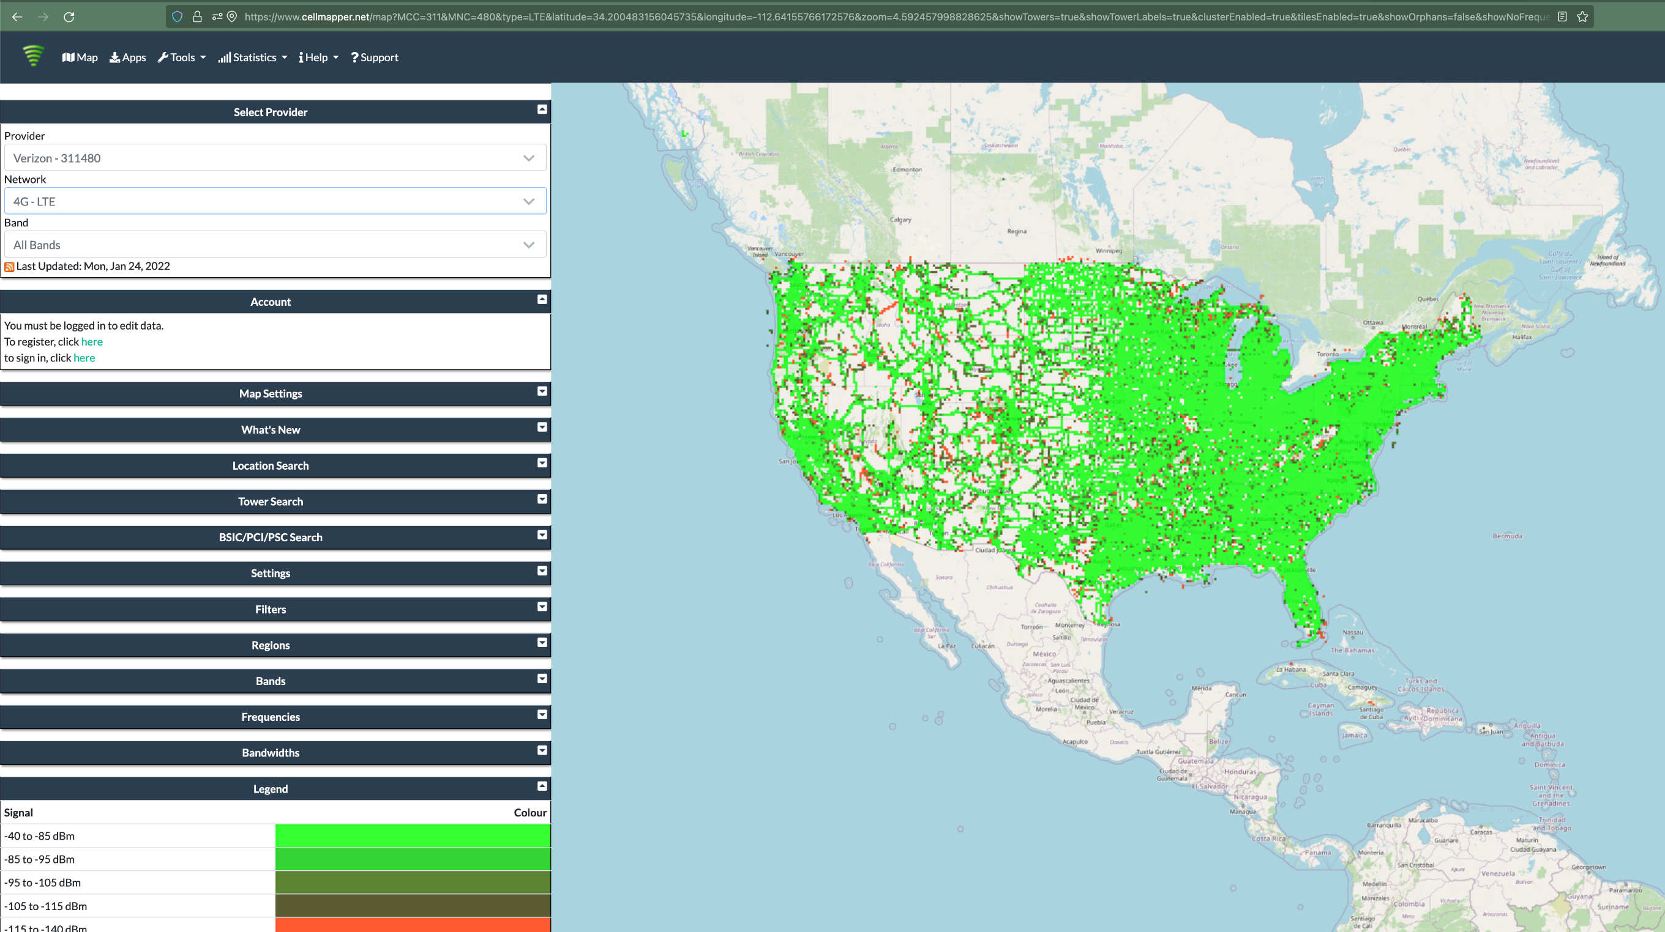
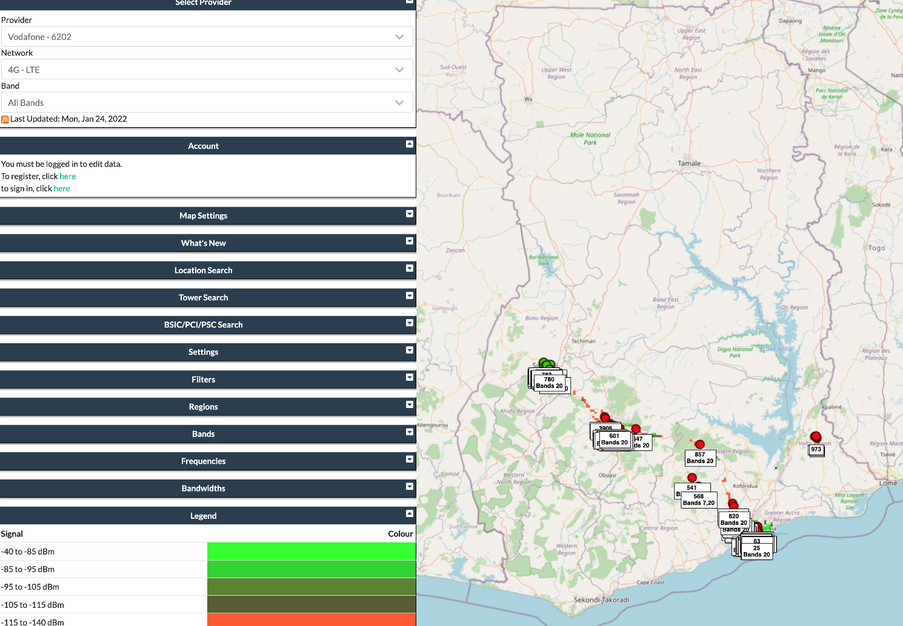
Quick reality check: Verizon?
And this is just crowd-sourced data…

Slide 34
LoRaWAN interested parties
MachineQ is a subsidiary of Comcast providing LoRaWAN networks
Long-term goal
Indoor-to-outdoor LoRaWAN gateways combined with WiFi/Cellular
Tune down power for 100-200 meter range
Current focus: IoT Platform-as-a-service
Devices, network, analytics

Slide 35
Break + Open Question
What kinds of use cases exist for LoRaWAN?
What can you do with 1-5 kbps uplink, 1-22 kbps downlink?
Multiplied by 64 channels uplink, 8 channels downlink

Slide 36
Break + Open Question
What kinds of use cases exist for LoRaWAN?
What can you do with 1-5 kbps uplink, 1-22 kbps downlink?
Multiplied by 64 channels uplink, 8 channels downlink
Outdoor small-sized sensing seems possibly achievable!
With a low enough rate, it could support many devices
Code updates on devices could be tough

Slide 37
Outline
Wide-Area Network Background
Unlicensed LPWANs
LoRaWAN
Sigfox
802.11ah
TV Whitespaces
LPWAN Challenges

Slide 38

Sigfox
Very low-rate (600 bps), very long-range (10+ km) communication
Star-topology networks, with always-listening gateways
Any number of low-power end devices
Uplink-focused communication
Applications: very low-rate metering

Slide 39
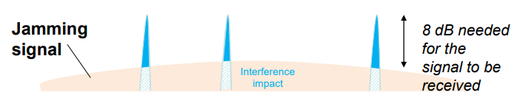
Sigfox PHY
Unlicensed-band communication
Europe 868 MHz. US 902-928 MHz (915 MHz band)
Ultra-narrowband 600 Hz (100 Hz Europe) channel bandwidth
Detection only needs to occur at very specific frequency
Helps improve signal-to-noise ratio

Slide 40
Sigfox unbalanced uplink and downlink
Uplink
600 Hz bandwidth, 600 bps, DBPSK
Downlink
1.5 kHz bandwidth, 600 bps, GFSK
Particularly optimized for Europe
Uplink on 1% duty cycle channel, up to 14 dBm
Downlink on 10% duty cycle channel, up to 27 dBm
Works fine in US too
Gets more power (24 dBm up is typical, up to 32 dBm down) and more range

Slide 41
Sigfox link budget
Why transmit at 100-600 bps?
For greatly increased link budget
Link budget: 150-160 dBm
Assuming Tx at ~20 dBm
Means Rx Sensitivity of -130 dBm (10 dBm better than LoRaWAN)
Resulting range: 10-15 km in urban environments
Except that buildings lead to dead spots in range

Slide 42
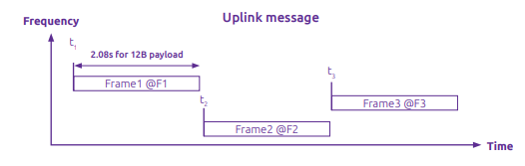
Sigfox MAC
Aloha-style access control (send whenever)
No acknowledgements!
Send message three times for increased reliability
Then listen for downlink at a set period later on a known frequency

Slide 43
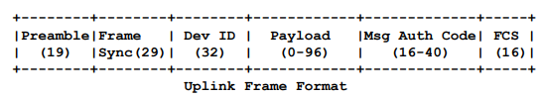
Sigfox uplink packet
Up to 29 bytes total per packet
Payload: up to 12 bytes 😱
Other fields
Preamble + Frame Sync are really a 6 byte field for radio sync
Authentication: 2-5 bytes
Frame Check Sequence: 16-bit CRC

Slide 44
Aside: why faster bitrate in the US?
Packet size up to 29 bytes (232 bits)
At 100 bps: 2.32 seconds on air
At 600 bps: 0.387 seconds on air
Maximum dwell time for 915 MHz band: 400 ms

Slide 45
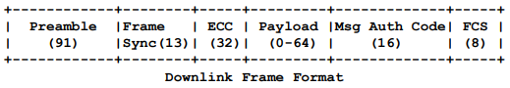
Sigfox downlink packet
Similar structure, 28 bytes total
Payload: up to 8 bytes
Larger preamble + frame sync of 13 bytes
Error Correcting Code for increased reliability

Slide 46
Sigfox deployments
Proprietary network with managed deployment
Like cellular networks
Sigfox deploys networks and transports data
140 uplink messages plus 4 downlink message per day
Connectionless communication
Devices are registered with the networks
Keys are provided in the software image
Any deployed Sigfox gateway can collect transmitted data
Enables mobile applications

Slide 47
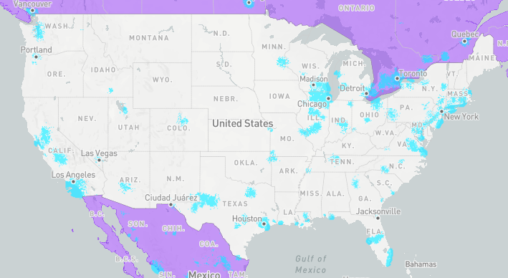
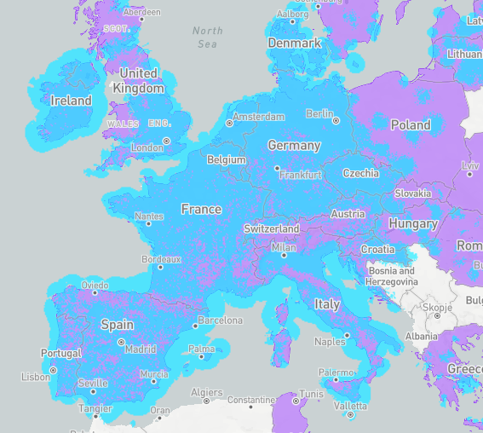
Sigfox coverage (Spring 2022)
Not focused on US coverage right now (coverage is blue)
Much higher availability in Europe
No longer planned rollout in US (purple)
January 2022
Sigfox filed for bankruptcy
April 2022
Sigfox purchased by UnaBiz

Slide 48
Break + Open Question
What kinds of use cases exist for Sigfox?
What can you do with 600 bps uplink, 600 bps downlink?
Multiplied by ?hundreds? of channels (~400 in Europe)

Slide 49
Break + Open Question
What kinds of use cases exist for Sigfox?
What can you do with 600 bps uplink, 600 bps downlink?
Multiplied by ?hundreds? of channels (~400 in Europe)
Many devices that aren’t doing very much
Simple status monitoring (water, electric, etc.)
Not metering necessarily, but activity detection
Did a breaker trip?, is water flowing?, etc.
Definitely no code updates

Slide 50
Outline
Wide-Area Network Background
Unlicensed LPWANs
LoRaWAN
Sigfox
802.11ah
TV Whitespaces
LPWAN Challenges

Slide 51
IEEE standard for LPWANs
802.11ah (HaLow) standard in 2016
First real hardware in 2020
Still not in real-world use yet
Focus on the indoor-to-outdoor scenario
Medium range (maximum 1 km)
915 MHz communication
NOT interoperable with other 802.11 access points and devices
Theoretically up to 356 Mbps
Practically, most devices are expected to implement 150 kbps to 8 Mbps

Slide 52
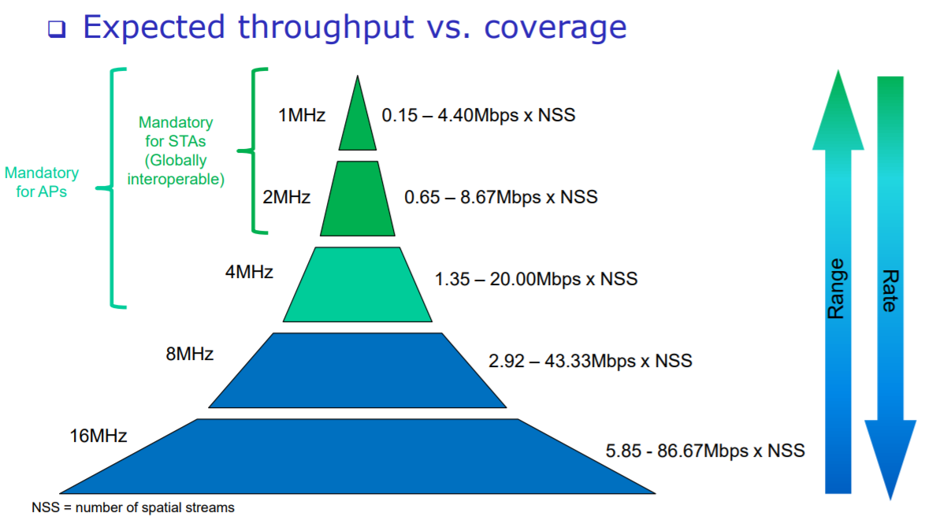
802.11ah allows multiple bandwidth allocations

Slide 53
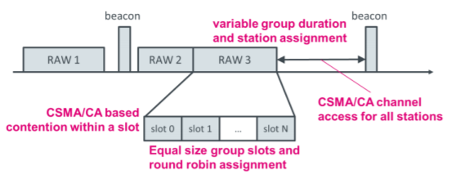
802.11ah architecture
Star topology
Up to 8191 devices per access point
Devices are assigned to a group
Groups are scheduled slots with TDMA
Within a slot CSMA/CA is used for contention among devices
Devices not in the group can sleep until their slot
Traditional IP communication on top of that
And traditional 802.11 security mechanisms (WPA2/TLS)

Slide 54
Outline
Wide-Area Network Background
Unlicensed LPWANs
LoRaWAN
Sigfox
802.11ah
TV Whitespaces
LPWAN Challenges

Slide 55
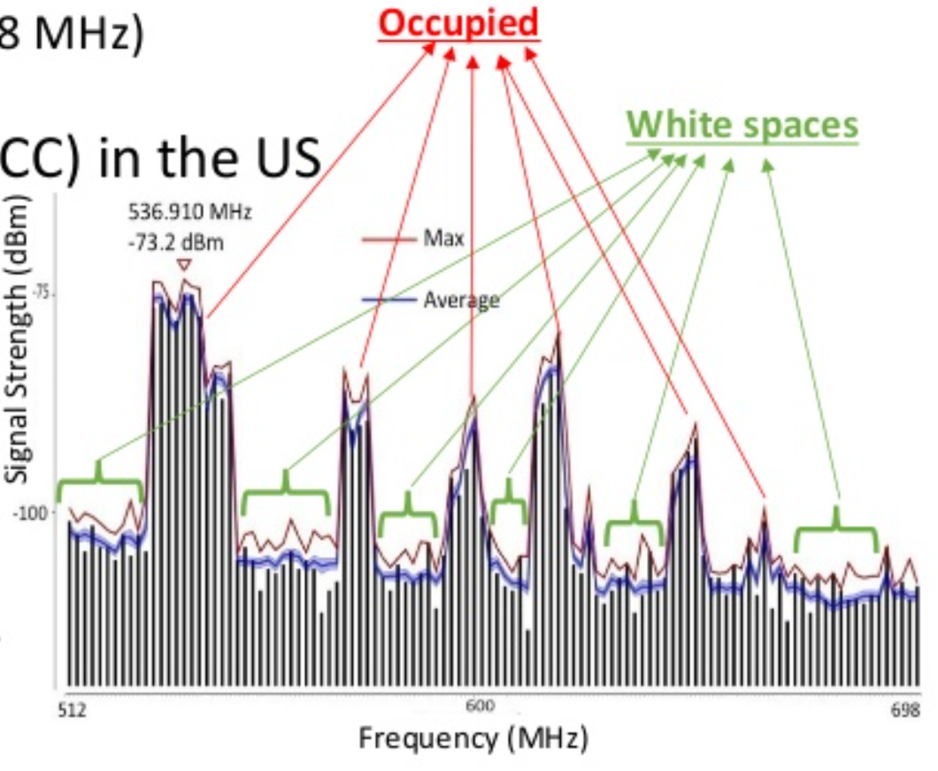
TV whitespaces
Unused TV channels between 54 MHz and 698 MHz
VHF (54-216 MHz)
UHF (470-698 MHz)
6 MHz channel width
Allocated but unused
FCC allows unlicensed use
IF you do not interfere with primary users

Slide 56
Sensing channel use
Variation in use
Spatial: Cannot assume same channel will be free everywhere
Temporal: Cannot assume channel will be free at all times
Cognitive radio approach
Dynamically identify unused portions of spectrum
Database approach
Let someone else do the scanning. Consult database based on location and time

Slide 57
802.11af
IEEE standard for whitespaces circa 2014
Not much (any?) use to date
US/Canada-specific
Limits general-purpose product appeal
Requires infrastructure about whitespace availability
People are figuring this out, but not really available yet
[n.b. very active area of research; including here]

Slide 58
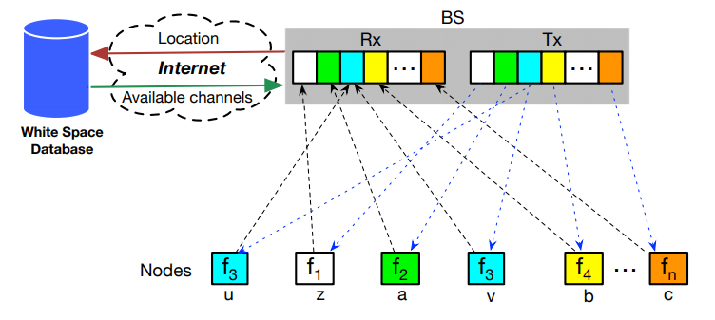
Sensor Networks Over tv Whitespaces (SNOW)
A design for sensor networks over whitespaces
Base Station manages channel for deployment
Frequency division for devices. Each uplinks on separate subcarrier
Downlink is one OFDM transmission. Each device hears its frequency

Slide 59
Break + Administrivia
Project Status Updates
Due on Friday by end-of-day
Presentations will be in-class on May 31 / June 02
Tuesday/Thursday of week 10
That’s two weeks from today!

Slide 60
Outline
Wide-Area Network Background
Unlicensed LPWANs
LoRaWAN
Sigfox
802.11ah
TV Whitespaces
LPWAN Challenges

Slide 61
Do novel networks meet application needs?
How do we compare varied requirements and capabilities?
Networks have throughput per gateway and range of gateway.
Applications have throughput per device and deployment area.
Each gateway must support throughput for all devices in its coverage area.
Deployment areas are often wider than a single gateway’s range.
Solution: compare the density of communication.
Data communication rate per unit area.

Slide 62
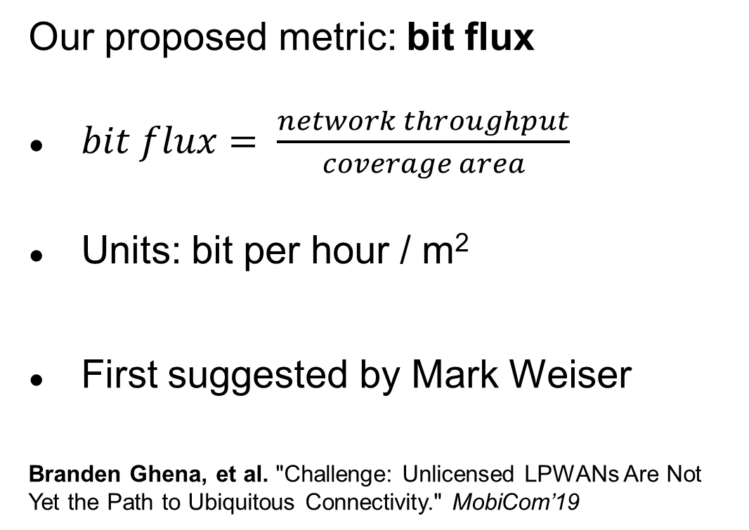
New metric for wide-area communication.
Our proposed metric: bit flux
$bit flux= \frac{network throughput}{coverage area}$
Units: bit per hour / m²
First suggested by Mark Weiser
Branden Ghena, et al. "Challenge: Unlicensed LPWANs Are Not Yet the Path to Ubiquitous Connectivity." MobiCom’19
Notes:
bit flux is our metric for data density
throughput divided by coverage area
As with many ideas, this was first suggested by Mark Weiser

Slide 63
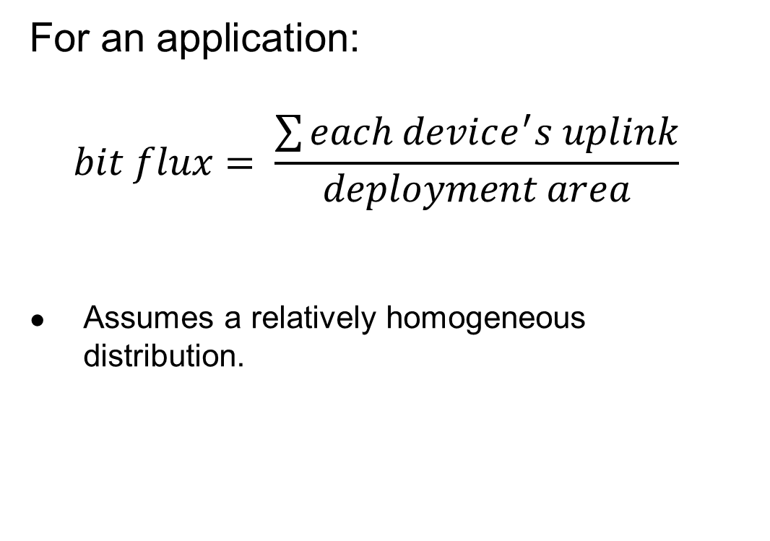
Bit flux can measure application needs.
For an application:
$$bit flux= \frac{\sum{each device^{′}s uplink}}{deployment area}$$
Assumes a relatively homogeneous distribution.
Notes:
For applications, bit flux sums the data needs for each device in the deployment
And divides by the total deployment area
To determine the application uplink density

Slide 64
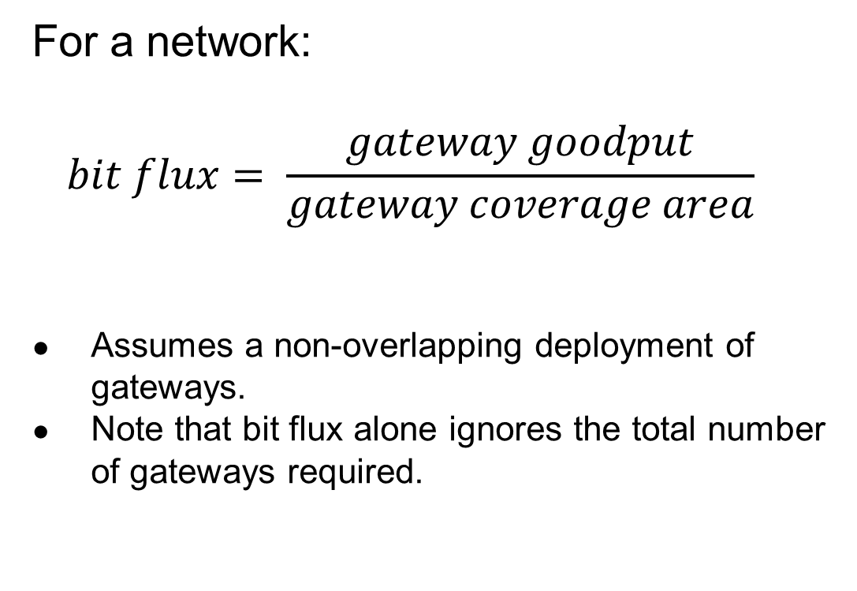
Bit flux can measure network capabilities.
For a network:
$$bit flux= \frac{gateway goodput}{gateway coverage area}$$
Assumes a non-overlapping deployment of gateways.
Note that bit flux alone ignores the total number of gateways required.
Notes:
For networks, we divide the goodput of a network
By the coverage area of a single gateway
This gives us a number that represents the data density that a network can support, at any width of deployment

Slide 65
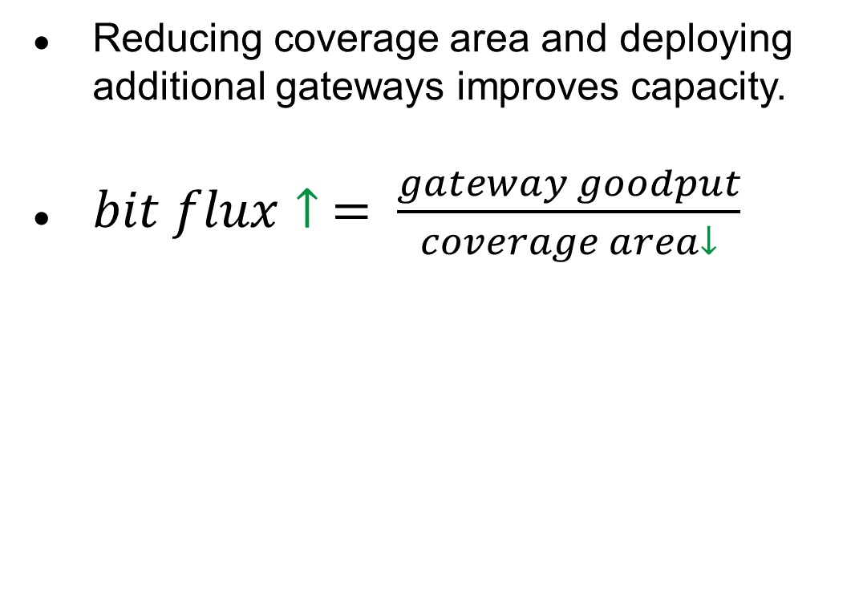
Bit flux accounts for spatial reuse.
Reducing coverage area and deploying additional gateways improves capacity.
$bit flux↑ = \frac{gateway goodput}{coverage area↓}$
Notes:
Bit flux also accounts for spatial reuse in networks
Reducing range (and deploying more gateways), reduces the coverage area for each gateway, increasing the network bit flux

Slide 66
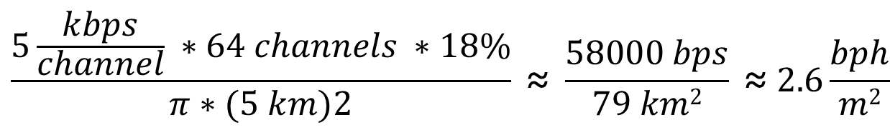
Bit flux measurement for LoRaWAN.
ALOHA access control
$$\frac{5\frac{kbps}{channel} ∗64 channels ∗18\%}{π∗(5 km)2} \text{≈} \frac{58000 bps}{79 km2} \text{≈} 2.6\frac{bph}{m2}$$
Hata model
Notes:
Here is the bit flux measurement for a LoRaWAN network
In the US, LoRaWAN has 64 channels for uplink
But it relies on an ALOHA access control mechanism, so packet collisions reduce throughput significantly

Slide 67
Networks differ in capability by orders of magnitude.
Notes:
We can calculate bit flux for each of the networks we’re interested in
We note that there are several orders of magnitude difference in the throughput capability of each network
Particularly between cellular communication and unlicensed LPWANs

Slide 68
Range reduction results in a bit flux curve for each network.
Notes:
These points are at the maximum range for each network, but they have the ability to perform power control and reduce range
This creates a curve for each network, where we can reduce range (and install more gateways) in order to increase network capability

Slide 69
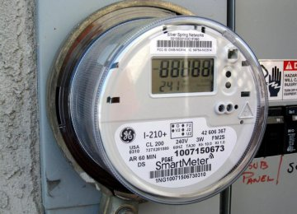
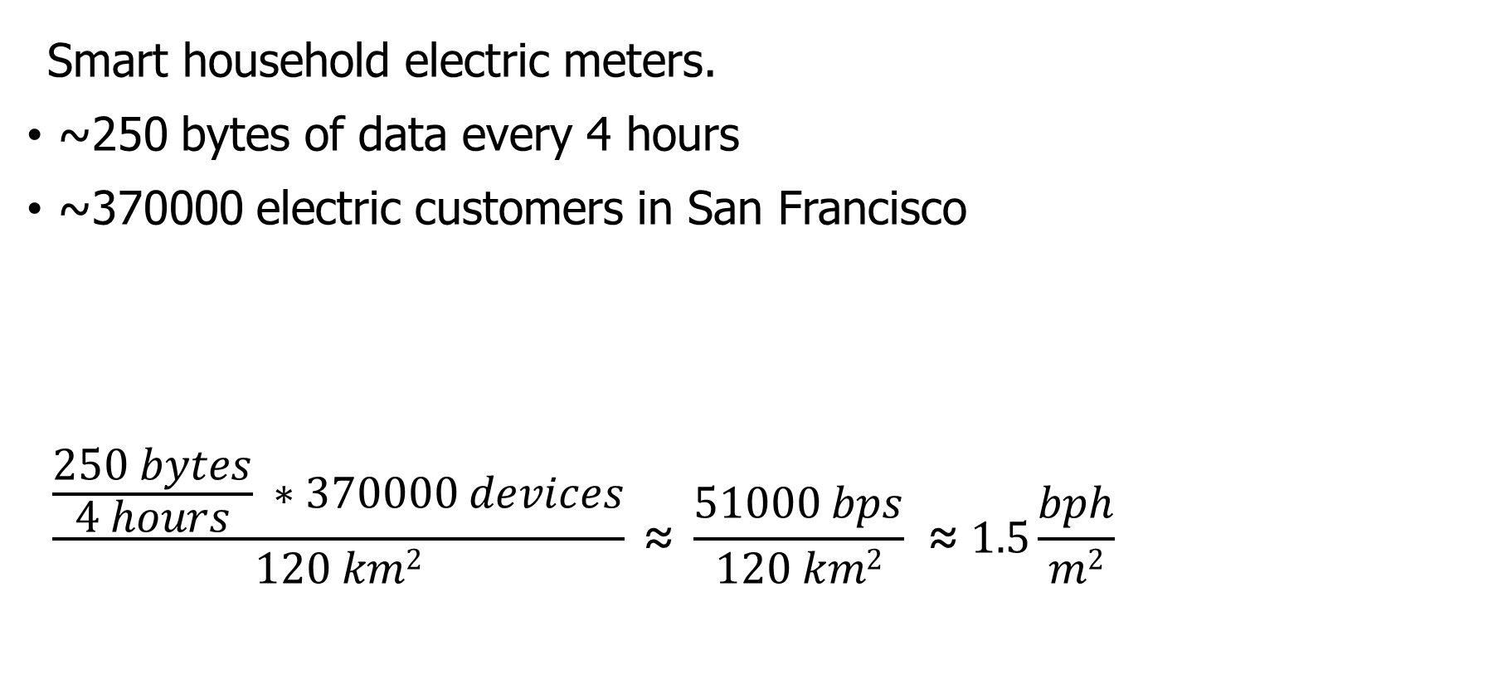
Let’s compare network capabilities to a real-world application.
Smart household electric meters.
~250 bytes of data every 4 hours
~370000 electric customers in San Francisco
$$\frac{\frac{250 bytes}{4 hours} ∗370000 devices}{120 km2} \text{≈} \frac{51000 bps}{120 km2} \text{≈} 1.5\frac{bph}{m2}$$
Notes:
Now that we can measure the capability of each network, lets compare that to the needs of an application
The example I’ll be talking through is Electricity Metering, there are about a dozen others in the paper
PG&E smart meters send about 250 bytes every 4 hours
This isn’t a lot of data, but smart meters are densely deployed, with three hundred thousand across San Francisco

Slide 70
All networks are capable of meeting the data needs of electricity metering.
Electricity Metering Application
Notes:
We can plot the need of the Electricity Metering application as a line on our bit flux figure
Any network above this line is capable of serving the application’s needs
Sigfox needs range reduction, but all networks are capable of serving this application’s needs
So, great! Networks can serve ubiquitous applications. Problem solved, right?

Slide 71
Unlicensed LPWANs lag behind Cellular IoT in ability to support applications.
2G < 0.03% utilized
Notes:
Let’s visualize this instead as the number of gateways deployed and the proportion of network utilized.
Again, because of power control, there is a tradeoff here. We could deploy a single gateway for everything, or many gateways with reduced range to increase capacity.
Cellular networks have no problem with this application
With a single gateway, LTE-M could spend 1% of its capacity to service this app.
Unlicensed LPWANs, however, have choices to make on how many gateways they deploy and how much capacity they are willing to spend on this one application

Slide 72
Sigfox requires range reduction to meet application needs.
Capacity Problem
Throughput capability of Sigfox is insufficient to support application needs
It can only support the application with reduced range and additional gateways
Notes:
There are two particular problems we can see with the unlicensed LPWANs
The first is a capacity issue:
Sigfox can’t satisfy the application at all without power control.
Range is sufficient for a single gateway to cover the city, but it wouldn’t be able to keep up with the data.

Slide 73
Capacity solutions are relatively straightforward.
Better access control mechanisms.
Recover simultaneous transmissions (Choir and Charm).
Increase bandwidth (TV white spaces).
All likely come at the cost of increased energy usage…
Results in a protocol that looks pretty similar to cellular…
Adwait Dongare, et al. "Charm: exploiting geographical diversity through coherent combining in low-power wide-area networks.“ IPSN’18
Rashad Eletreby, et al. "Empowering low-power wide area networks in urban settings." SIGCOMM’17
Abusayeed Saifullah, et al. "SNOW: Sensor network over white spaces." SenSys’16
Notes:
Solving these capacity problems is relatively straightforward
And a lot of research from our community has begun that path
One solution would be better access control mechanisms than the ALOHA
We could also significantly increase the available bandwidth through the use of TV white spaces

Slide 74
LoRaWAN devotes most of its network capacity to a single application.
Coexistence Problem
LoRaWAN can meet application needs
But only by using 50% of the 915 MHz unlicensed-band spectrum
Notes:
But there is a second problem, that of coexistence
LoRaWAN could handle the application with only 2 or 3 gateways
Remember, that we are calculating bit flux for LoRaWAN using all available channels
As long as you are willing to commit 50% of the 915 MHz spectrum to electricity metering

Slide 75
Coexistence is inevitable in urban areas.
Urban environments and long range lead to many overlapping deployed networks.
Capacity problems worsen coexistence by devoting more bandwidth to one application.
It’s not just electricity metering…
Notes:
You might try to say it’s fine to dedicate so much of a network to a single application. I dedicate 50% of my home WiFi to Netflix all the time…
But coexistence cannot be ignored in urban areas
There won’t just be one network, but two, or three, or more
And they all have to share the same bandwidth for all deployed applications

Slide 76
Coexistence in unlicensed bands is a more difficult problem.
No methods for inter-network negotiation so far.
Without buy-in from most deployments, all access control becomes uncoordinated.
Cellular IoT does not have this problem
Notes:
Solving these coexistence problems are more difficult
We need methods for coordination and negotiation between deployed networks
And without buy-in from all networks, collisions are inevitable
It doesn’t matter that you are using a wonderful scheduling TDMA algorithm to send data without collisions if your neighbor is transmitting whenever they want
And a really important point is that cellular IoT doesn’t face this problem

Slide 77
Cellular may dominate future deployments.
LTE-M and NB-IoT are now deployed in the US (and worldwide).
Licensed bandwidth avoids the coexistence problem.
Cellular may solve many applications but is not a perfect solution.
Still has higher energy and monetary costs for use.
Also limited to where service is already available.
Notes:
Occupying licensed bands means LTE-M and NB-IoT don’t have multiple overlapping networks to coordinate with
So coexistence isn’t a concern
And they already have more capacity than the unlicensed protocols
Without solutions for unlicensed LPWANs, deployments will move to cellular networks
And when the applications leave, research will leave as well
Without real solutions to the problems they face, we’re in danger of losing an exciting research domain
We pose this as a challenge to the community to develop coexistence and capacity solutions for unlicensed LPWANs

Slide 78
Unlicensed LPWANs are still useful for some scenarios.
Controlled or unoccupied regions have reduced coexistence concerns.
Industrial factories, farms, parks and forests.
Unlicensed networks are very exciting for research.
Anyone can deploy a network wherever they want.
Much easier to explore protocol modifications and new technologies.
Research suffers without real-world applications.
Problem areas are strong recommendations for new research.
New research is only useful if they will have real-world impacts.

Slide 79
Implications – Low-Power Wide-Area Networks.
Existing unlicensed LPWANs face significant challenges in supporting urban applications.
Best suited for industrial or agricultural uses in controlled environments.
Research directions for unlicensed LPWANs:
improve network capacity,
and enable coexistence.
Cellular IoT networks (LTE-M and NB-IoT) are positioned to solve the needs of city-scale sensing.
If the money and energy costs are there.

Slide 80
Outline
Wide-Area Network Background
Unlicensed LPWANs
LoRaWAN
Sigfox
802.11ah
TV Whitespaces
LPWAN Challenges

